Slide 1
Capstone Project: Netflix Data

Slide 2
Overview
In this project, I acted as a data visualization developer at Yahoo Finance! In this hypothetical role I helped the "Netflix Stock Profile" team visualize Netflix stock data.
The following visualizations are included in the presentation:
The distribution of the stock prices for the past year
Netflix's earnings and revenue in the last four quarters
The actual vs. estimated earnings per share for the four quarters in 2017
A comparison of the Netflix Stock price vs the Dow Jones Industrial Average price in 2017

Slide 3
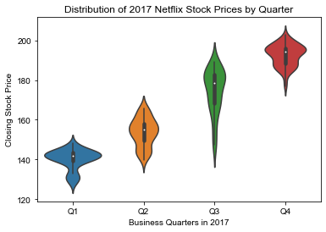
Quarterly Distribution of Netflix Stock Prices (2017)
Netflix Stock Prices increased throughout the course of 2017.
Mostly, the stock price fell in the 140 - 180 range.
The lowest price was about 130 (Q1).
The highest price was about 210 (Q4).

Slide 4
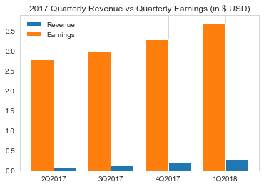
2017 QR vs QE
Revenue tends to increase over time.
Earnings tend to increase over time.
Roughly, 14% of the revenue constitutes earnings.

Slide 5

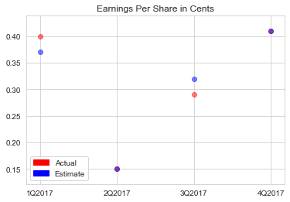


EPS in Cents
Red dots are the Actual EPS.
Blue dots are the Estimated EPS.
Purple dots are where the Actual and the Estimated EPS overlap.

Slide 6
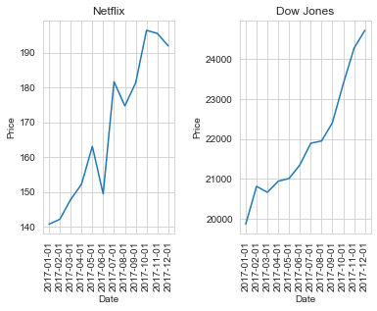
Netflix (2017) vs
DOW (2017)
Netflix performed well in relation to the DOW.
Netflix’s stock was more volatile in relation to the DOW.
The DOW’s overall price is much larger (generally), but this is to be expected.

